Slide 1




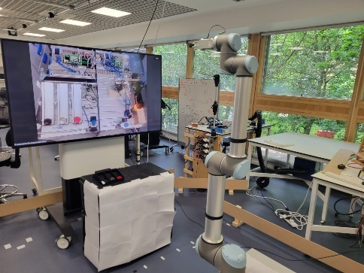
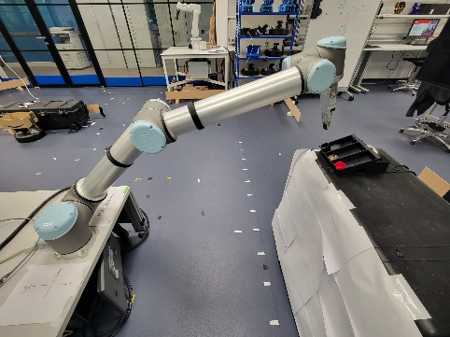
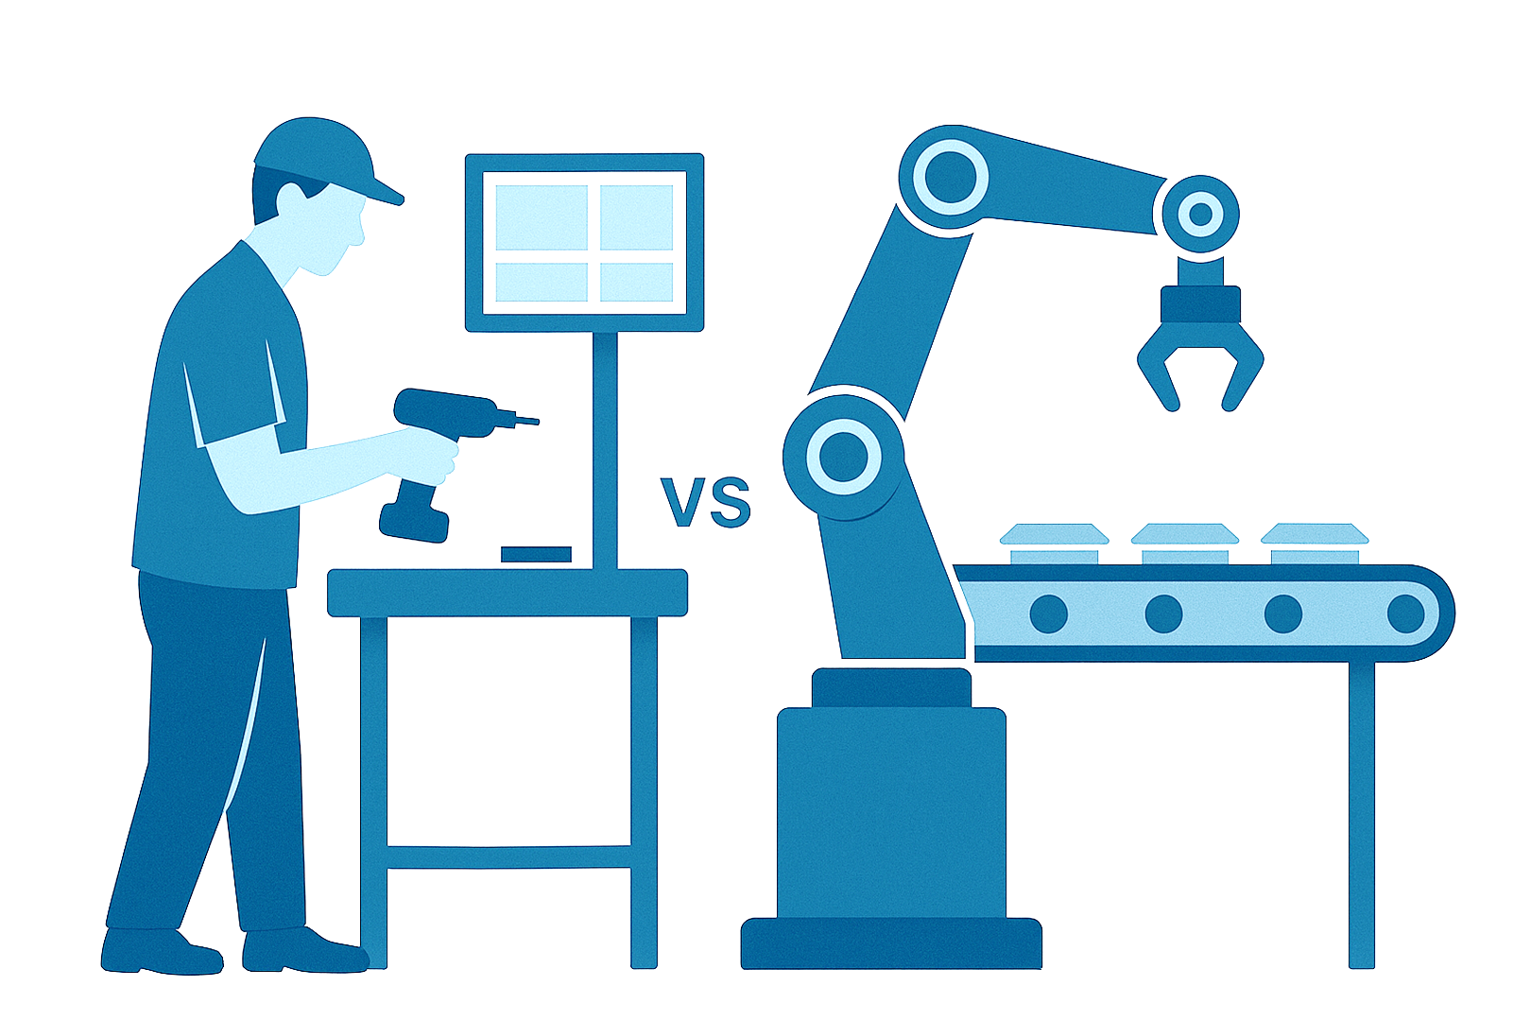
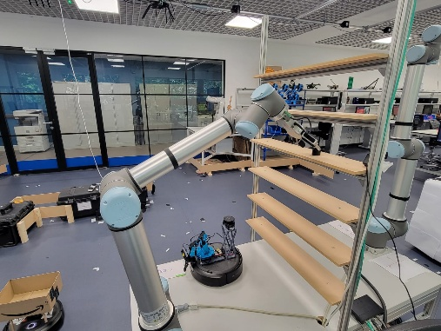
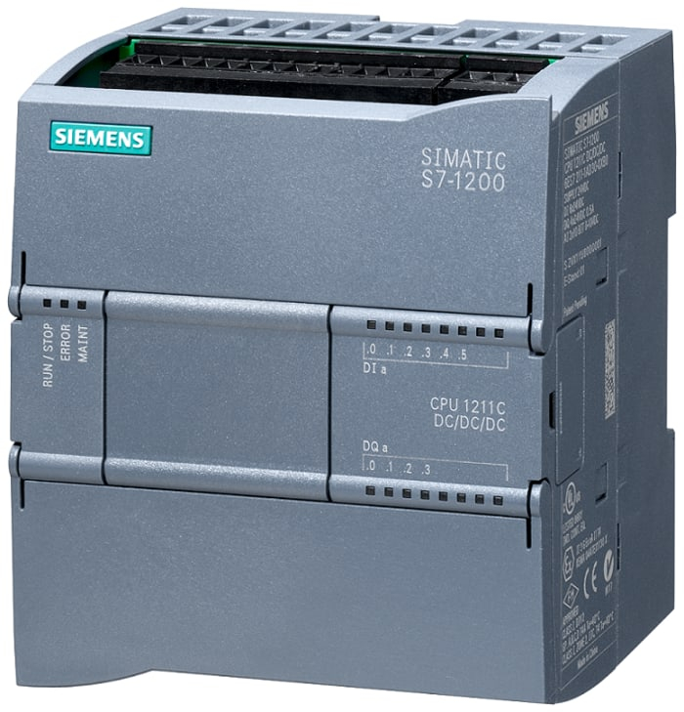
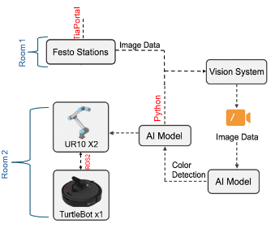

Automated Assembly Line with Festo Stations,
UR10 Arms, and TurtleBots
By Adebolanle O. Okuboyejo and Sela Shapira
Background
Manual sorting slows productivity, and causes quality issues.
Limited real-time coordination between systems.
Need for location-independent, scalable automation.
Project objectives
Design and implement an automated system that combines Cobots, mobile robot and a PLC controlled machinery.
Solution
Festo MPS stations releases lids based on internal logic.
YOLOv8 model detects colour in real time.
A UR10 picks a lid and places it on the TurtleBot.
The TurtleBot transfers the lid to the shelving area.
A second UR10 robot places the lid on the correct shelve.
System components
Festo MPS Sorting Stations (x2).
Siemens PLC.
UR10 Robotic Arms (x2):
TurtleBot.
Camera & Object Detection System.
User Interface.
Software & integration
Siemens TIA Portal: Programmed the PLC to sort and release lids autonomously.
Python: Managed YOLO-based lid detection and communicated tasks to the robots via ROS 2.
ROS 2: Served as the middleware for seamless communication between vision, robots, and logic.
Siemens configuration
S7 series PLC was used.
Interrupt routines and timers were written in TiaPortal.
Digital inputs from Festo sensors triggered lid sorting.
Workflow
Vision based coordination between the Festo stations, Turtlebot and UR10.
Stations and robots located in different rooms.
Real time, location-independent operation.
The Turtlebot transports the lids to the shelves.
Operation
Shown here are images from the operation phases of the system
Statistics
The primary goal was to evaluate the vision-based detection system for its:
Accuracy.
Responsiveness.
Reliability.
The main results from these tests are shown in the table below.
Conclusion
The system can work continuously without human intervention.
The results proved the effectiveness of Vision based systems communication.
Manual
Automated
whole configuration
picking the lid
putting the lid on the shelve
Siemens PLC
Parameter | Measured value | Expected/target value | Notes
System downtime | 0% | < 5% | No interruptions during testing
Initialization time | 6 seconds | ≤ 10 seconds | Full system startup.
Pick and place success | 100% per test batch | ≥95% | No missed or dropped lids.
Robot response time | 4 seconds | 4 – 6 seconds | Time from detection to the beginning of the pick.
Scan for demonstration video

